Slide 1
Crafting and Compelling Website Analysis , Audit & Recommendations.
Ramya Raghavan
MB 28
Capstone Project -IV

Slide 2
Apple India
Apple India is a subsidiary of Apple Inc., focusing on the company's operations in the Indian market. Established to cater to the growing demand for Apple products in India, the company handles sales, marketing, and support for devices like the iPhone, iPad, Mac, and accessories.
Key Aspects:
Market Presence: Apple has been expanding its presence in India, tapping into the rising middle class and increasing smartphone adoption. The company has opened physical retail stores and enhanced its online presence.
Local Manufacturing: To comply with government regulations and reduce costs, Apple has been investing in local manufacturing through partnerships with companies like Wistron and Foxconn.
Services: Besides hardware, Apple India also focuses on software services like the App Store, Apple Music, and iCloud, catering to the growing digital services market in the country.
Innovation and Education: Apple has initiatives aimed at promoting education and innovation, including partnerships with educational institutions to support coding and app development.
Sustainability Efforts: Apple is committed to sustainability, focusing on reducing its environmental impact through recycling programs and using renewable energy in its operations.
Overall, Apple India plays a crucial role in Apple's global strategy, leveraging India's vast consumer base and talent pool.

Slide 3
Apple India - Products
iPhone
iPhone 14: Features a 6.1-inch Super Retina XDR display, A15 Bionic chip, dual-camera system with improved low-light performance, and long battery life. Available in various colors.
iPad
Pad Pro: Available in 11-inch and 12.9-inch sizes, it boasts the M1 chip, Liquid Retina display, and support for Apple Pencil (2nd generation) and Magic Keyboard, making it ideal for creative and professional use.
Mac
MacBook Air: Sleek and lightweight with a Retina display, powered by the M2 chip, offering impressive performance and battery life. Ideal for everyday tasks and light creative work.
Apple
Watch
Accessories
iPhone SE (3rd Generation): Compact design with a 4.7-inch Retina HD display, powered by the A15 Bionic chip, and features Touch ID for secure authentication.
iPad Air: Features a 10.9-inch Liquid Retina display, powered by the M1 chip, and supports Apple Pencil and Magic Keyboard, blending power and portability.
MacBook Pro: Available in 14-inch and 16-inch models, equipped with the M1 Pro or M1 Max chips, designed for professionals needing high performance for demanding applications
Apple Watch Series 9: offers advanced health tracking features including heart rate monitoring,ECG and blood oxygen monitoring along with customizable watch face and fitness tracking
Air Pods Pro: Wireless earbuds featuring Active Noise Cancellation, Transparency mode, and a customizable fit for immersive sound quality.
Apple Pencil: A versatile tool for drawing and note-taking on iPad, offering precision and low latency for creative tasks.

Slide 4
Website Platform Identification
Apple India | Technology Stack
Ecommerce | Cart functionality
Webmail | Apple icloud mail
Development | Anima
Maps | Apple Mapkit JS
Javascript Farmeworks | React(18.2.0)
Shipping Carriers | UPS
Security | HSTS
Personalization | Adobe Target(2.11.4)
Javascript Libraries | Lodash(4.17.21) Preact
A/B Testing | Adobe Target(2.11.4)
Analytics | Adobe Analytics
Miscellaneous | Open Graph

Slide 5
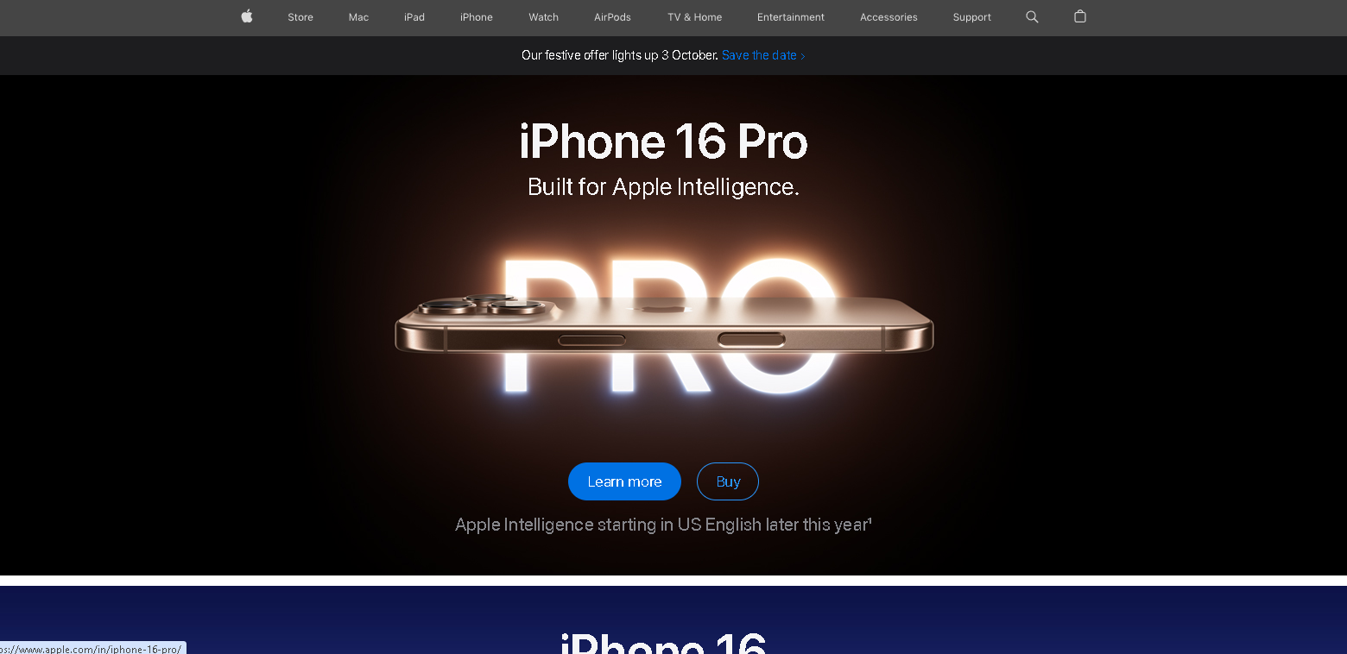
Website Mistakes Identification
User Journey Complexity
Issue: Navigation can be confusing for new users, leading to potential drop-offs during critical paths (e.g., purchasing).
Impact: Increased bounce rates and lower conversion rates as users may abandon their sessions.
Streamline User Journey
Action: Simplify navigation by categorizing products more intuitively and reducing the number of clicks required to reach key sections.
Benefit: Decreases bounce rates and increases conversion by providing a smoother user experience.

Slide 6
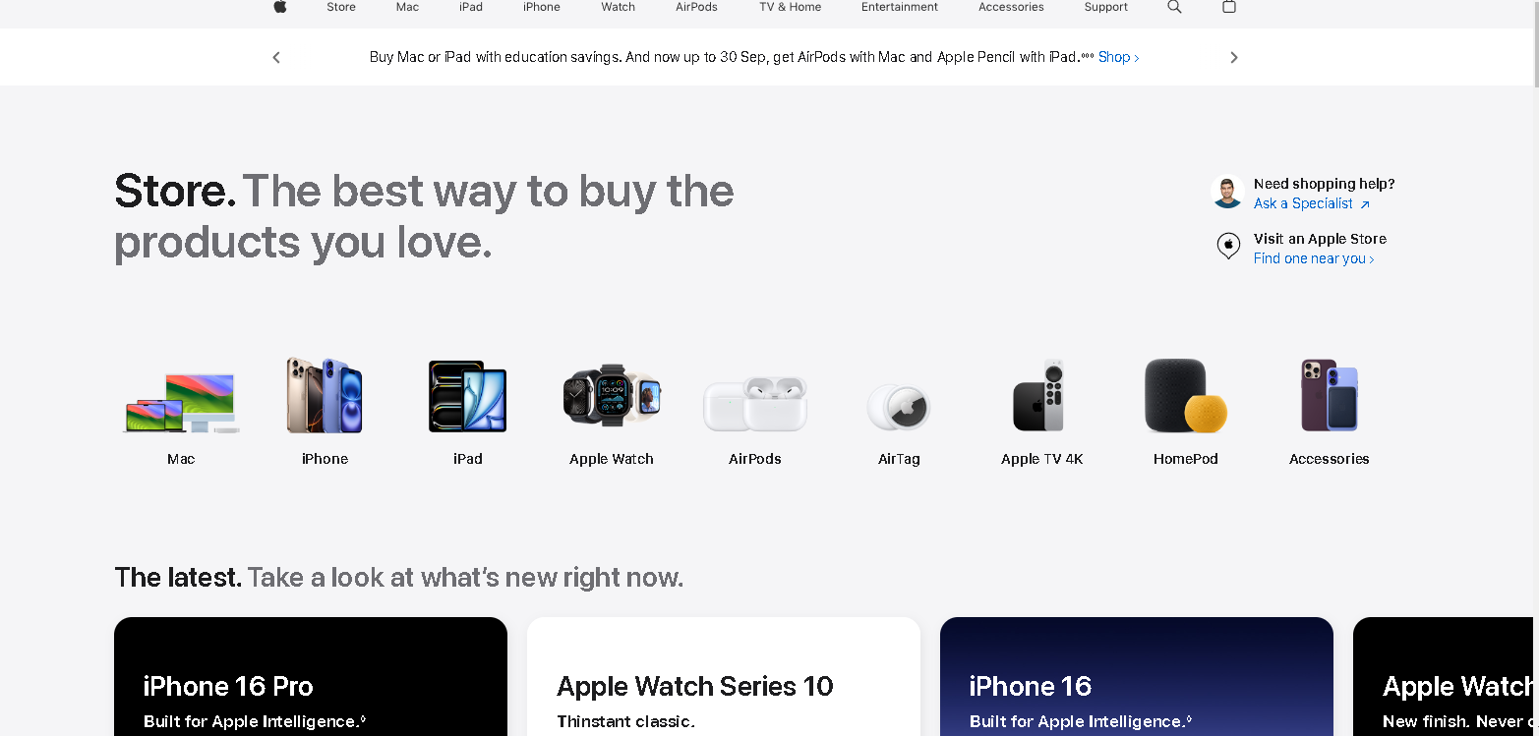
Website Mistakes Identification
Performance Bottlenecks
Issue: Loading times can vary, particularly on mobile devices or slower connections.
Impact: Slower performance can lead to user frustration, negatively affecting brand perception and sales.
Optimize Performance
Action: Conduct regular performance audits and optimize images and scripts for faster loading times across devices.
Benefit: Enhances user experience and reduces abandonment rates, especially on mobile.

Slide 7
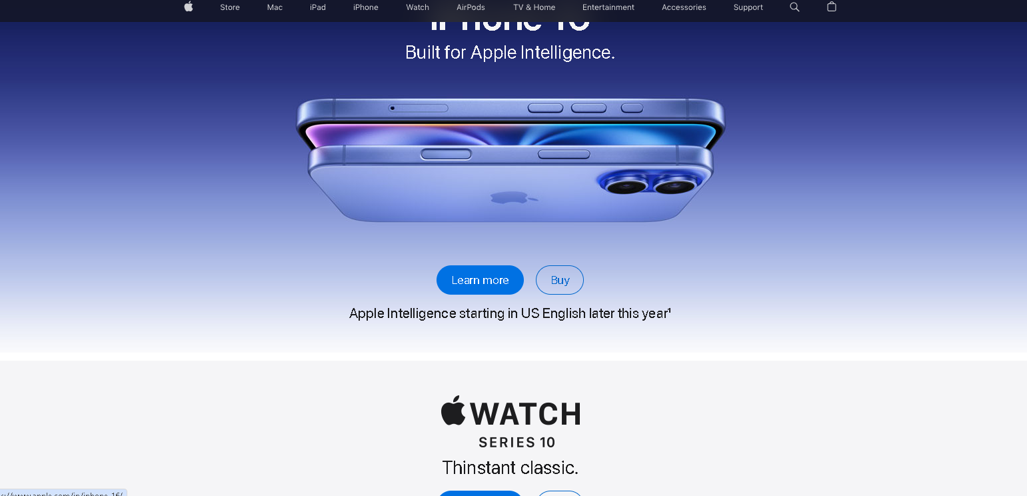
Website Mistakes Identification
Content Overload
Issue: The homepage and product pages may present too much information or promotions at once.
Impact: Users may feel overwhelmed, leading to indecision and reduced engagement.
Reduce Content Overload
Action: Simplify the homepage layout by prioritizing key messages and limiting promotional content.
Benefit: Improves user focus and decision-making, leading to higher engagement.

Slide 8
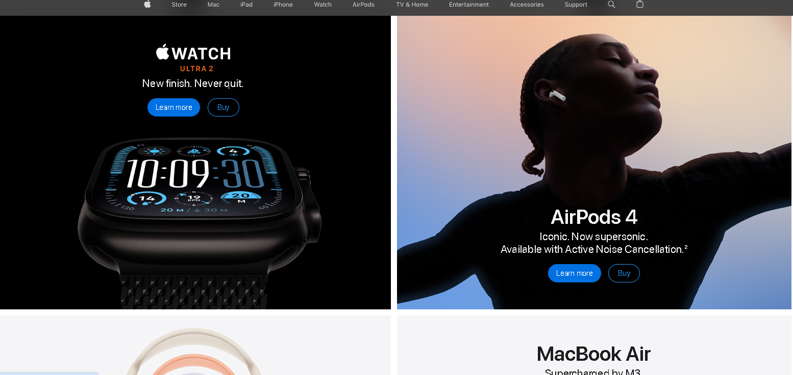
Website Mistakes Identification
Limited Comparative Tools
Issue: The website doesn’t provide robust product comparison features.
Impact: Customers may require more time to make decisions, which could lead them to competitors’ websites.
Develop Robust Comparative Tools
Action: Introduce a user-friendly product comparison feature that allows side-by-side analysis of multiple products.
Benefit: Facilitates quicker decision-making, potentially increasing conversion rates.

Slide 9
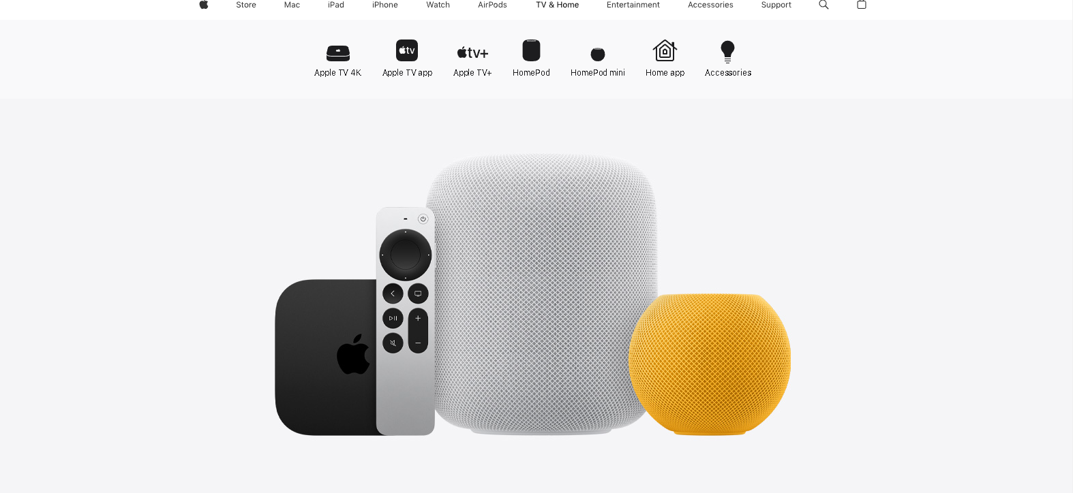
Website Mistakes Identification
Accessibility Concerns
Issue: The site may not fully comply with accessibility standards, making it difficult for users with disabilities to navigate.
Impact: Potential loss of customers and legal implications due to non-compliance.
Ensure Accessibility Compliance
Action: Conduct an accessibility audit and implement necessary changes to comply with WCAG (Web Content Accessibility Guidelines).
Benefit: Expands the user base, enhances brand reputation, and mitigates legal risks.

Slide 10
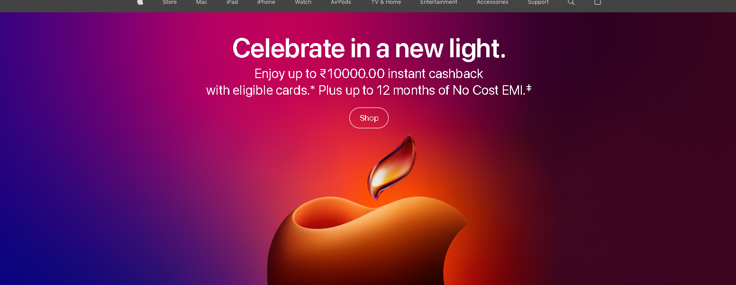
Responsive Design Test Report A Business Analyst Perspective
User Engagement Metrics
Failure: Content overflow and layout inconsistencies lead to navigation challenges on mobile devices.
Business Impact: Increased bounce rates can significantly affect conversion rates, leading to lost sales opportunities. A seamless mobile experience is crucial, especially for a brand known for its premium offerings.
Conduct Regular Usability Testing: Implement comprehensive testing on various devices to identify and resolve usability issues proactively.

Slide 11
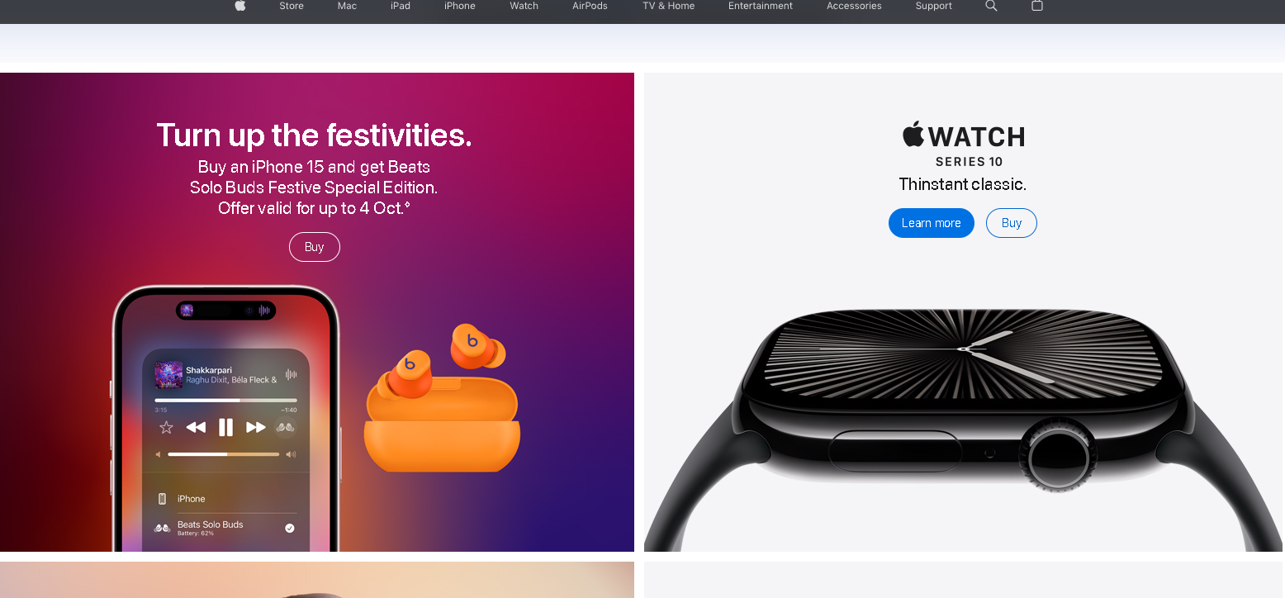
Responsive Design Test Report A Business Analyst Perspective
Performance and Load Times
Failure: Unoptimized images and resources can slow page load times, particularly on mobile networks.
Business Impact: Slow load times can deter users and lead to higher abandonment rates. Additionally, performance is a key factor in search engine ranking, impacting organic traffic and visibility.
Optimize Images and Resources: Use responsive images and efficient coding practices to improve load times and overall site performance.

Slide 12
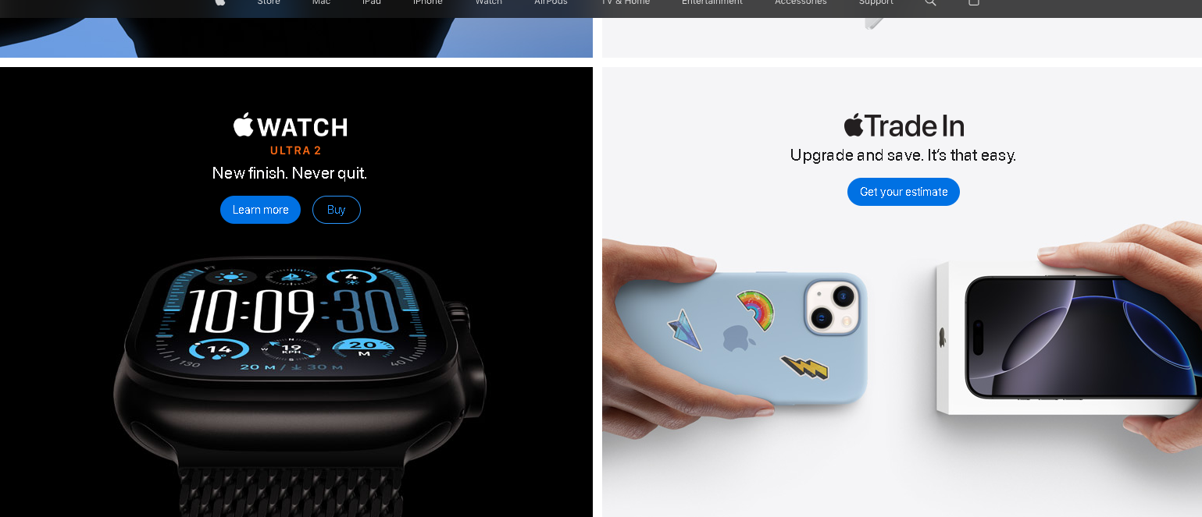
Responsive Design Test Report A Business Analyst Perspective
Accessibility Compliance
Failure: Issues with text readability and touch target sizes may not meet accessibility standards.
Business Impact: Non-compliance with accessibility guidelines can lead to legal risks and harm the brand's reputation, particularly for a company that positions itself as inclusive and user-centric.
Enhance Accessibility Features: Ensure compliance with accessibility standards to create an inclusive experience for all users.

Slide 13
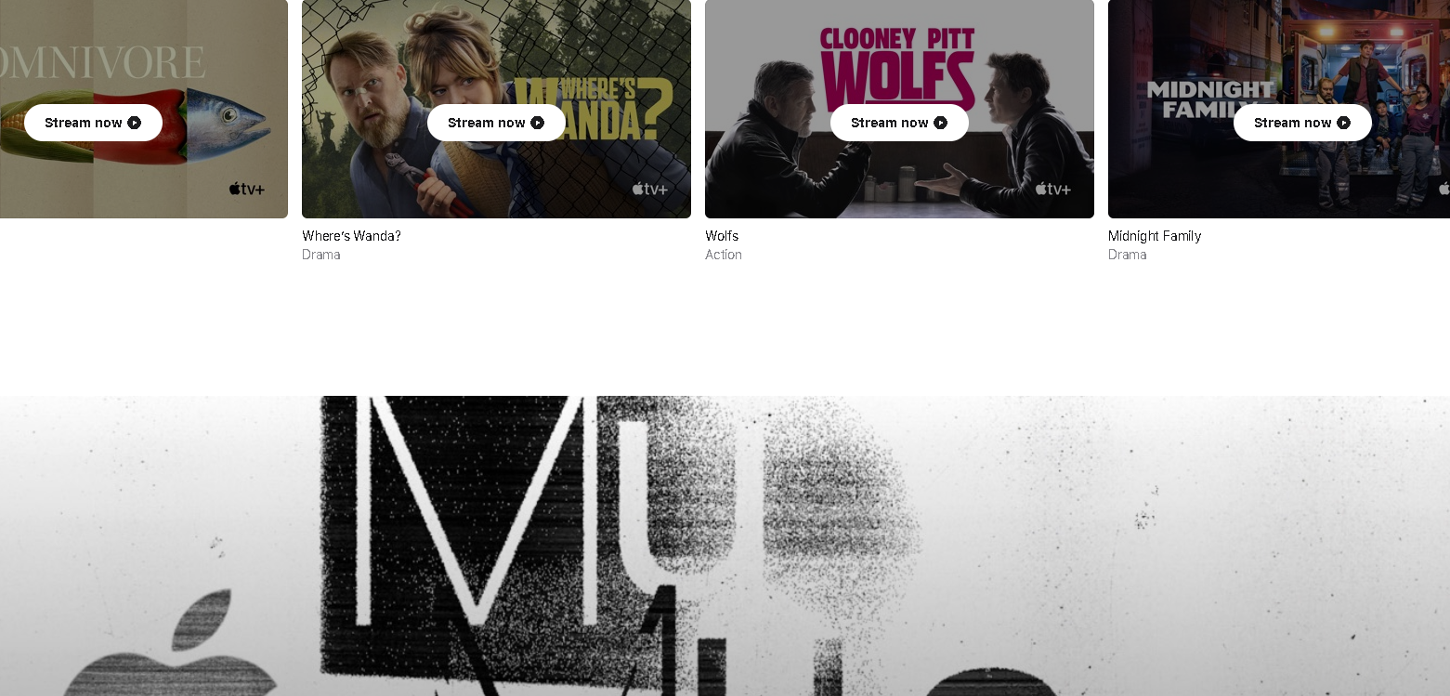
Responsive Design Test Report A Business Analyst Perspective
User Testing Feedback
Failure: Inadequate testing across diverse devices may overlook usability issues that affect the customer journey.
Business Impact: Feedback indicating frustration with navigation or interaction can necessitate costly redesigns and result in decreased customer satisfaction, affecting brand loyalty.
Implement Robust Analytics: Set up accurate analytics tracking to gather detailed insights on user behavior and inform future design decisions.

Slide 14
Best Practices List
1. Understand User Needs
Conduct user research (surveys, personas).
Analyses user behaviour data.
2. Define Clear Objectives
Align design goals with business objectives
Establish KPIs for measurement.
3. Collaborate with Stakeholders
Engage with designers, developers, and marketers.
Facilitate workshops for input.

Slide 15
Best Practices List
4. Create User Journey Maps
Visualize user interactions.
Identify critical touchpoints.
5. Prototyping and Wire framing
Use low-fidelity wireframes for layout.
Test usability with prototypes.
6. Monitor Analytics and Performance
Track user behaviour with analytics tools.
Regularly analyse data for insights.

Slide 16
Best Practices List
7. Incorporate Feedback Loops
Use A/B testing and usability tests.
Iterate based on user feedback.
8. Focus on Accessibility
Meet WCAG standards for wider reach.
Consider diverse user needs.
9. Implement SEO Best Practices
Collaborate with SEO experts.
Optimize content and images.

Slide 17
Best Practices List
7. Plan for Scalability
Design for future growth and features.
Ensure robust architecture.
11. Benchmark Against Competitors
Analyze competitor websites for insights.
Identify trends and differentiation.
12. Communicate Insights Clearly
Present findings visually and clearly.
Support recommendations with data.

Slide 18
Landing Page
https://my-work-in-canva.my.canva.site/mobile-landing-page

Slide 19
Thank you

